Slide 1






STOCK MARKET PREDICTION
Predicting Stock Prices using Machine Learning

Slide 2

THE
STOCK
MARKET

Slide 3

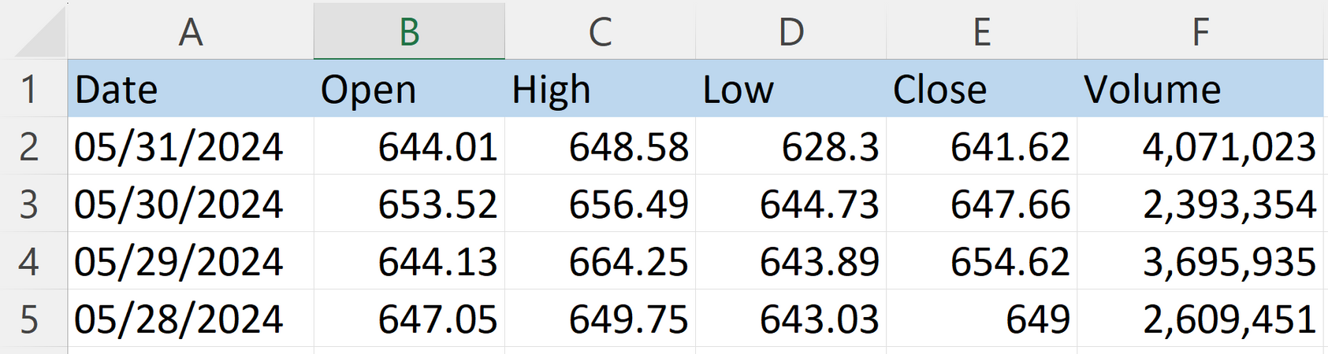

DATASET OVERVIEW
We used historical stock data for NFLX, which includes the following features: 'Open,' 'High,' 'Low,' 'Close,' and 'Volume.'
The dataset covers daily stock prices, providing a comprehensive view of the market's fluctuations over time.

Slide 4


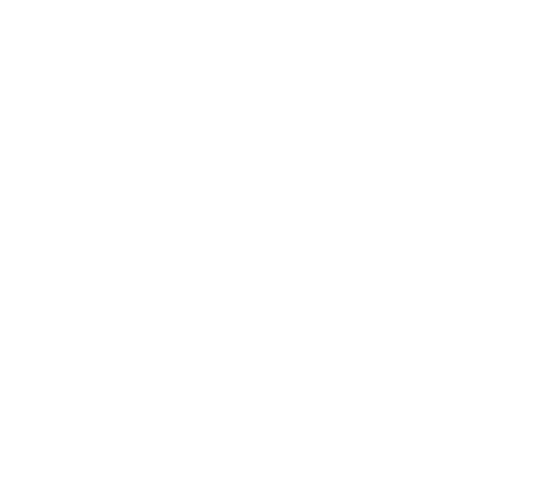

PROBLEM STATEMENT & APPROACH
The goal of our project is to accurately predict the 'Open' price of NFLX (Netflix) stock using historical stock data.
The 'Open' price is the price at which a stock first trades upon the opening of the stock market on a given day.
Accurate prediction of this value is crucial for traders and investors, as it can influence trading strategies and investment decisions.

Slide 5
MODEL SELECTION
We experimented with various machine learning models to predict the stock prices, including:
A simple yet powerful model for continuous prediction.
01 - LINEAR REGRESSION
An ensemble of decision trees that improves accuracy.
02 - RANDOM FOREST
A model that splits data into branches for prediction.
03 - DECISION TREE
A model that builds trees sequentially to minimize errors.
04 - GRADIENT BOOSTING
A model that tries to fit the best line within a threshold.
05 - SUPPORT VECTOR REGRESSION (SVR)

Slide 6


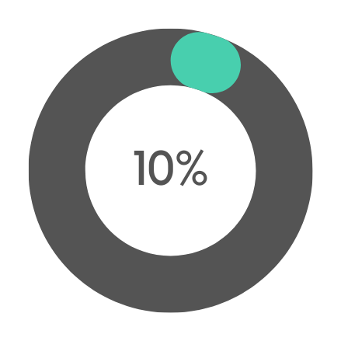

TRAINING THE MODELS
The dataset was split into training and testing sets with a 90-10 split ratio.
TRAINING
TESTING

Slide 7
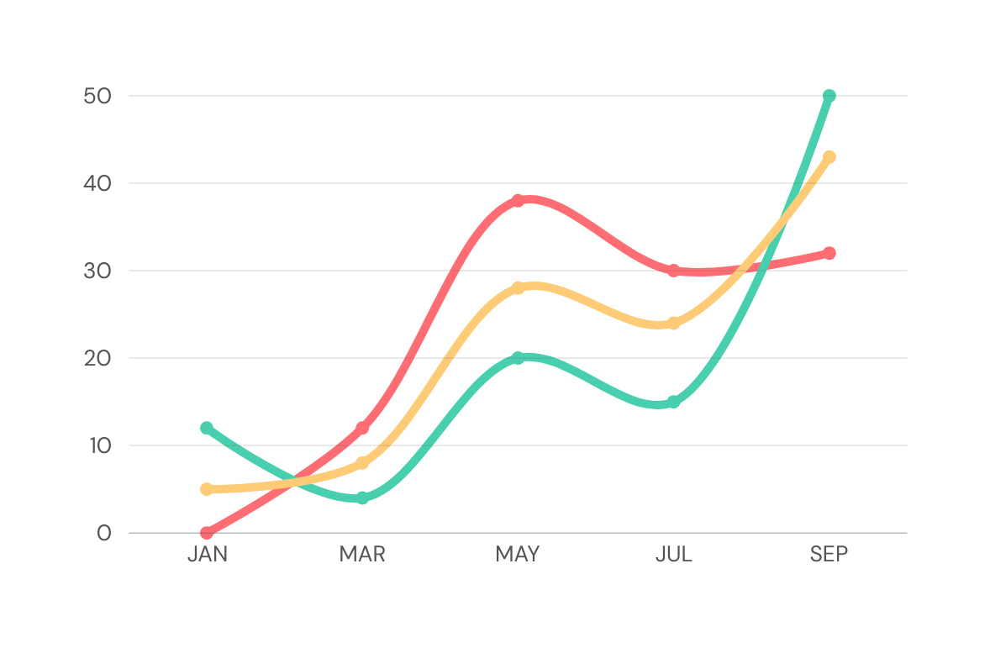
MODEL EVALUATION
The models were evaluated based on their prediction accuracy using the test data
We used the model score (R^2) as the primary evaluation metric
MODEL 1
MODEL 2
MODEL 3

Slide 8

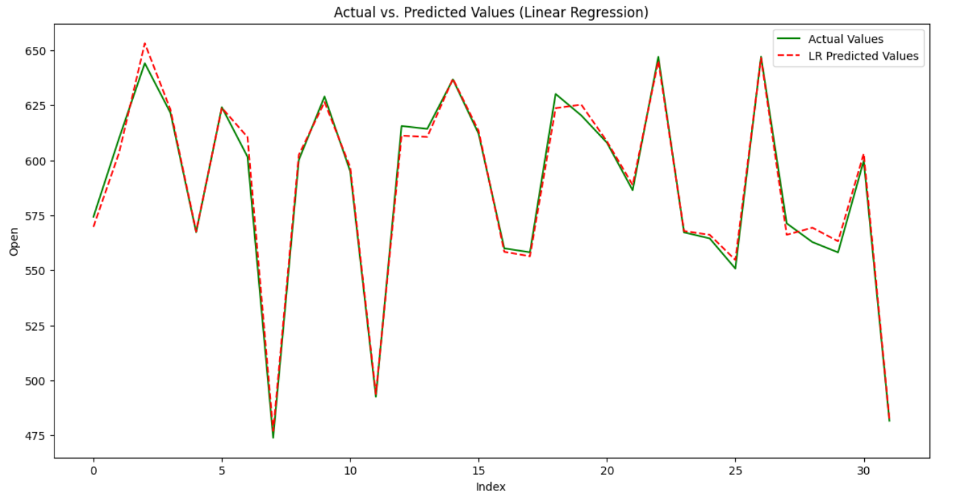
RESULTS
01 - LINEAR REGRESSION
Page 1

Slide 9
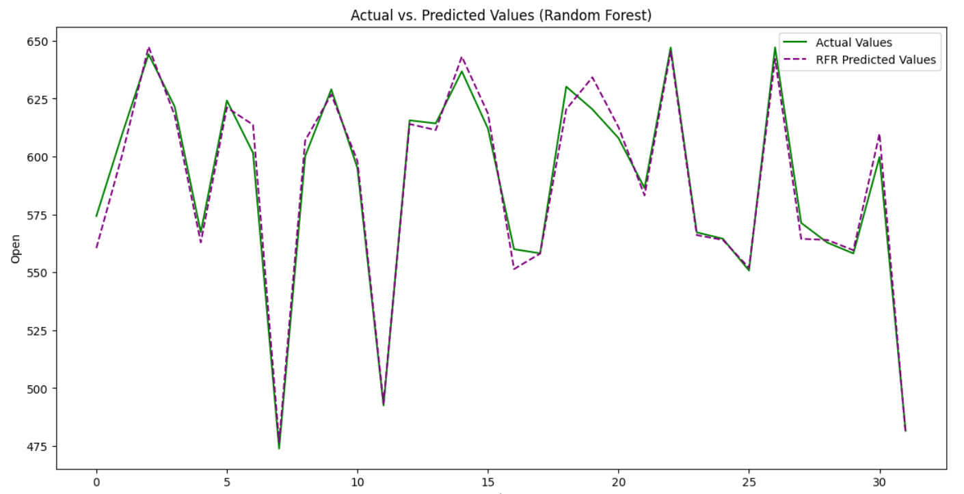
RESULTS
02 - RANDOM FOREST
Page 2

Slide 10
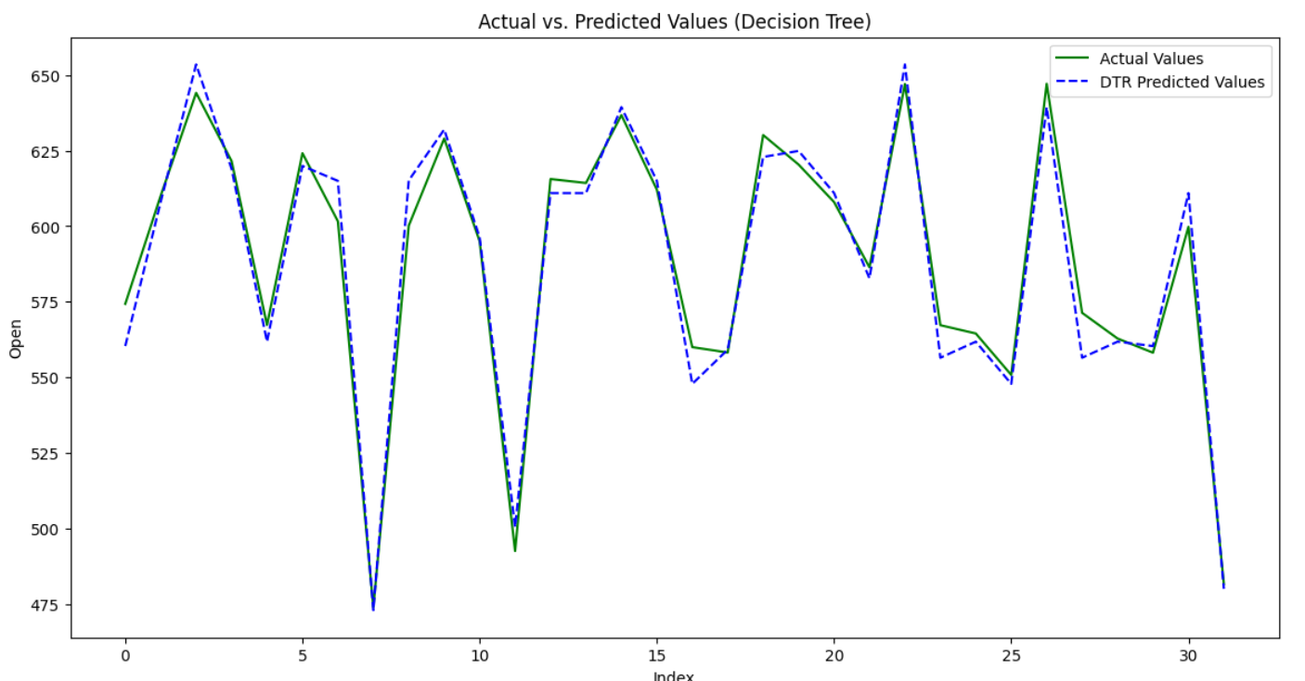
RESULTS
03 - DECISION TREE
Page 3

Slide 11
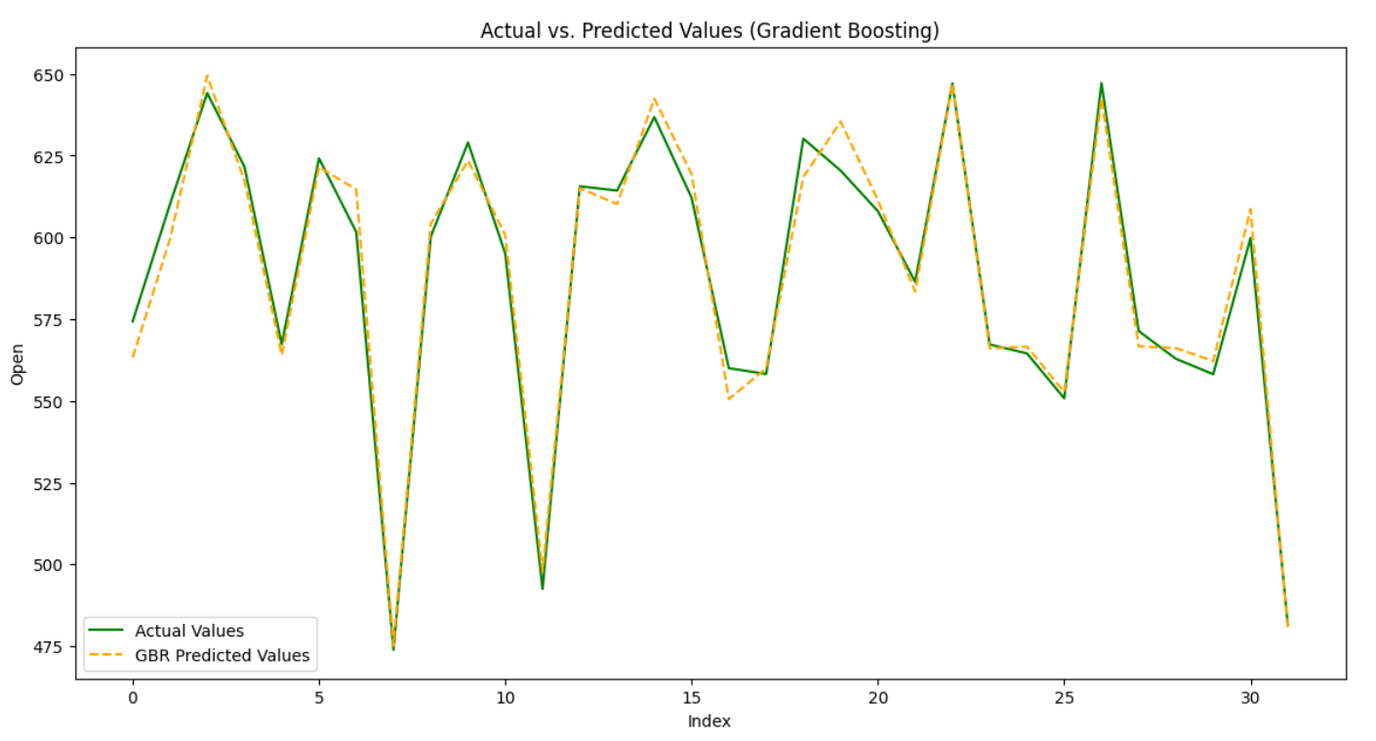
RESULTS
04 - GRADIENT BOOSTING
Page 4

Slide 12
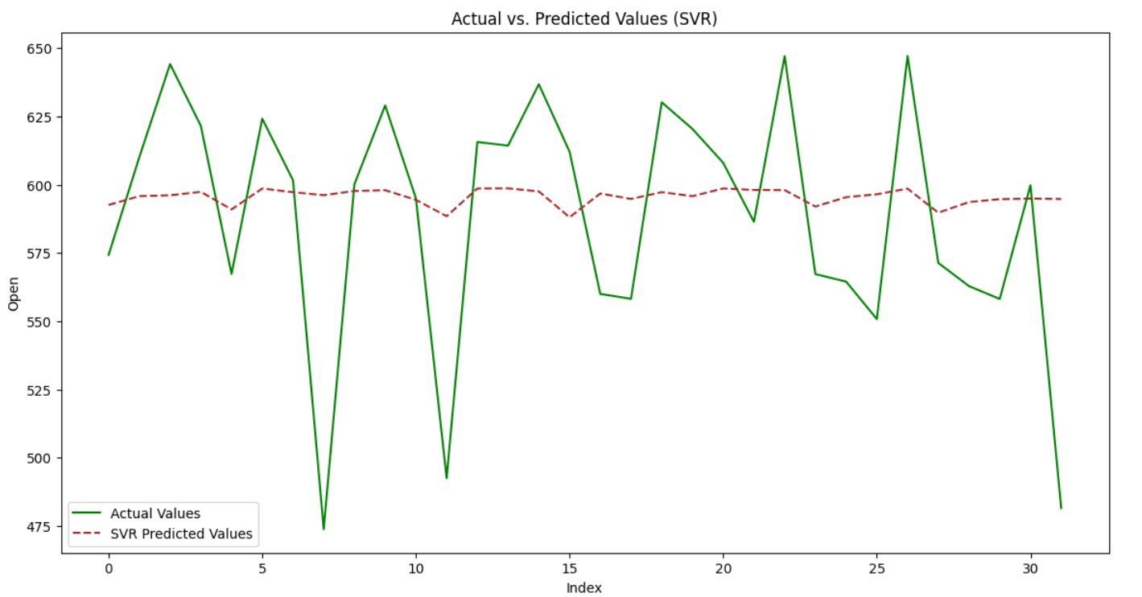
RESULTS
05 - SUPPORT VECTOR REGRESSION (SVR)
Page 5

Slide 13
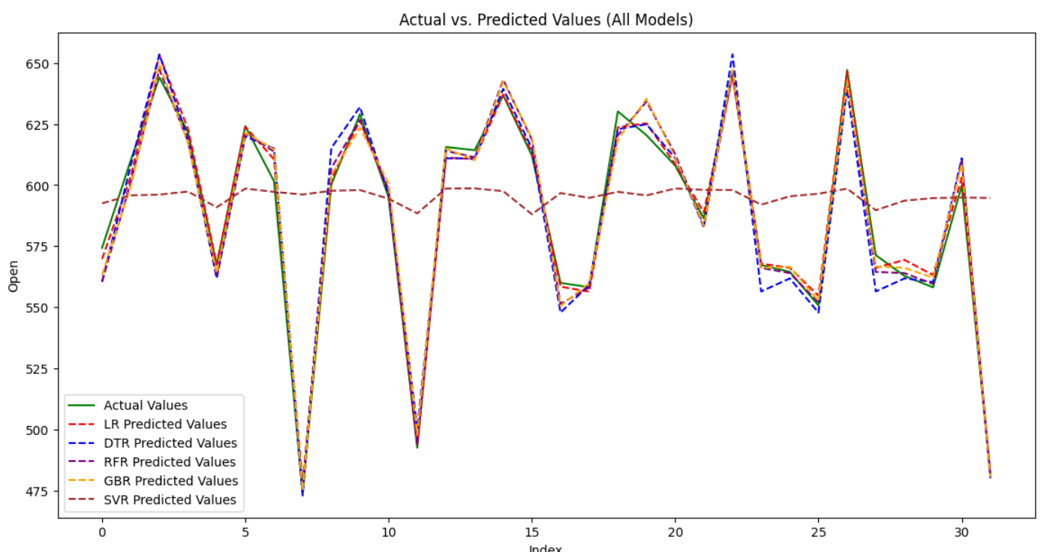
RESULTS
(All Models)
Page 6

Slide 14

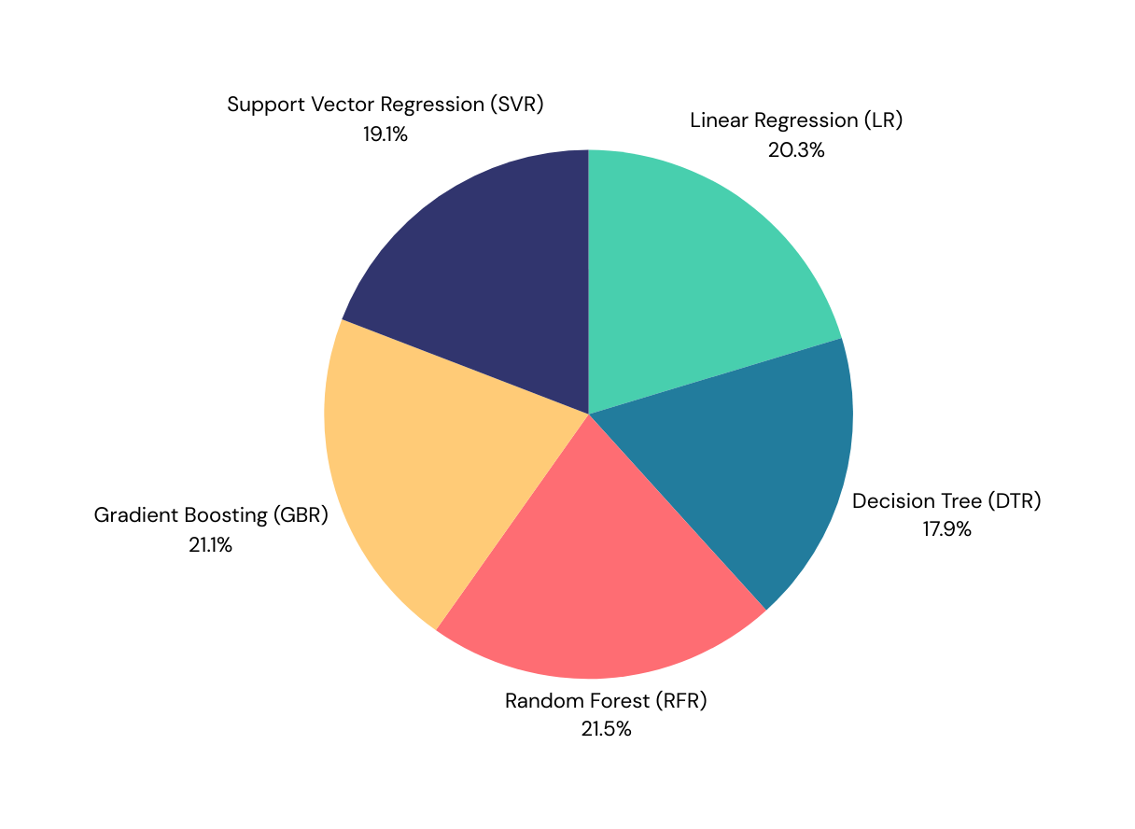
OVERALL RESULT
Linear Regression and Random Forest performed well, closely matching the actual prices
Gradient Boosting also showed promising results, while Decision Tree and SVR had some variance.

Slide 15
SUMMARY
Random Forest provided the best balance of accuracy and stability, making it the most reliable model for our dataset

Slide 16
THANK YOU
”STOP DREAMING
AND START
DOING”

